Slide 1


The Anna Karenina Paradox
Is the title misleading? An NLP analysis
Jakhongir erkinov (100001943)
Joranas cigas (100001693)
daved Tawdros(100002565)
Chriswin baiju (100001868)

Slide 2

agenda
Introduction
Context: The Anna vs Levin problem
Our Approach
Volume Analysis (Quantity)
Influence analysis (Quality)
Final Verdict

Slide 3

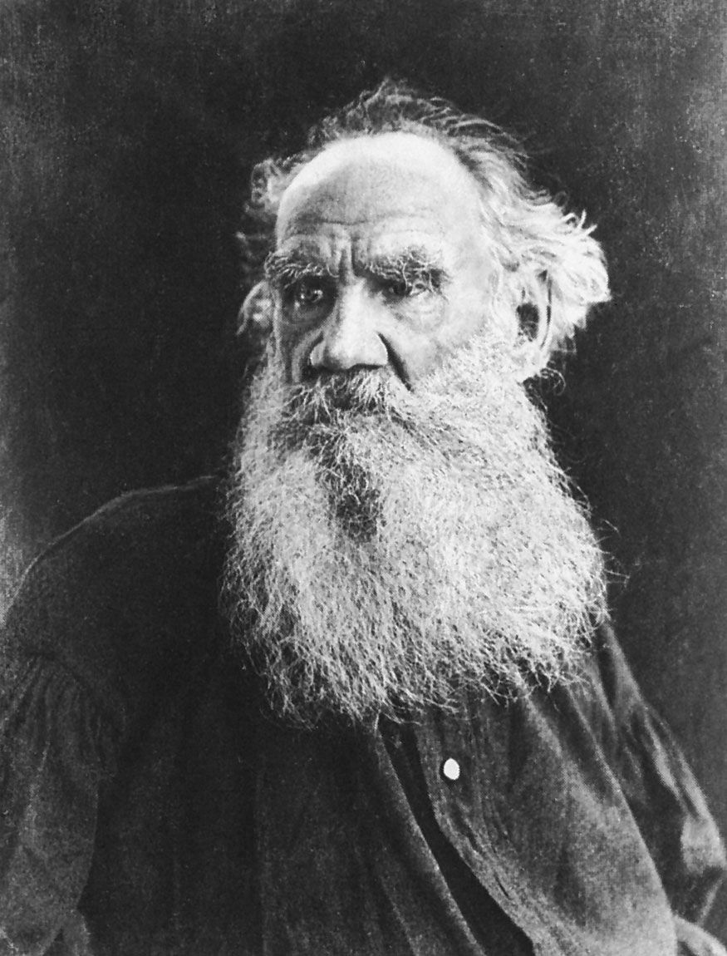
Leo tolstoy
Russian author (1828–1910)
Wrote epic realist novels
Known for psychological depth + huge casts

Slide 4

CONTEXT: THE ANNA VS LEVIN PROBLEM
The Expectation: Title suggests Anna is the sole protagonist.
The Reality: Konstantin Levin appears just as often.
The Twist: Levin is Tolstoy's semi-autobiographical self-portrait.
Research Question: Does the data support the title?

Slide 5
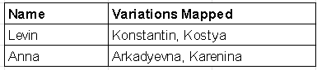
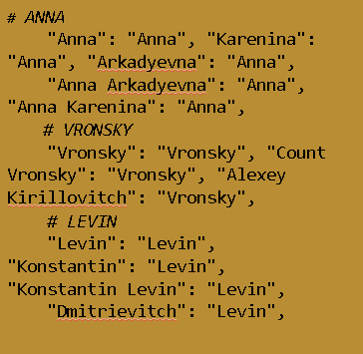
Our approach: nlp & mapping
The tool: Python Natural Language Processing (NLP) pipeline.
The Challenge: Russian names are complex and inconsistent.
The solution: We built a dictionary to map them..
Metrics: Volume (Counts) vs. Influence (Network).

Slide 6

Quantity Analysis (Volume)
THE EVIDENCE FOR LEVIN
1st Metric

Slide 7

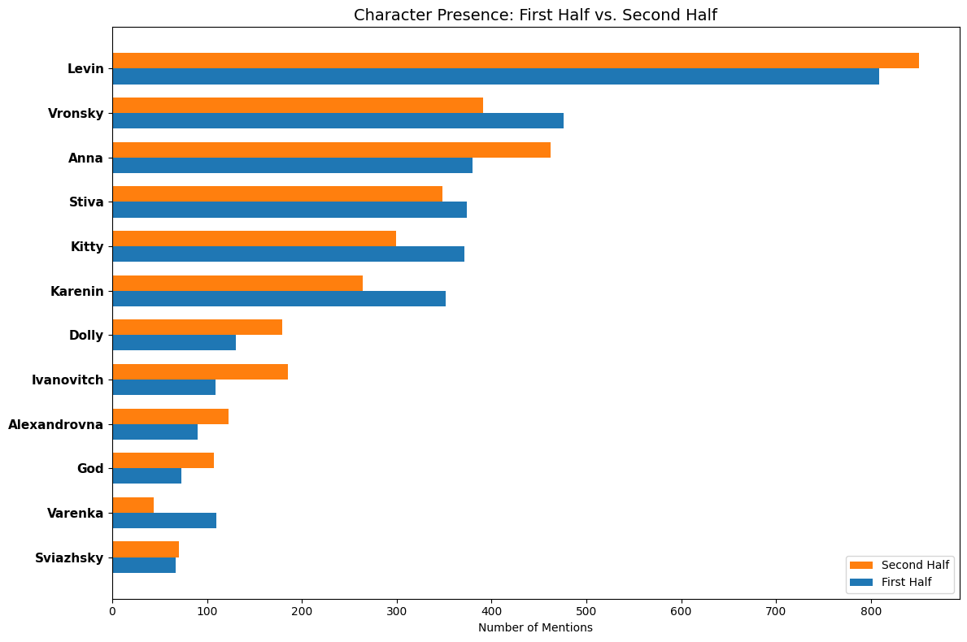
TOTAL MENTIONS
Bullet points:
Levin ~1,600 mentions
Anna ~1,100 mentions
Levin appears significantly more often
Tools: pandas, NLTK/spaCy, regex, matplotlib

Slide 8
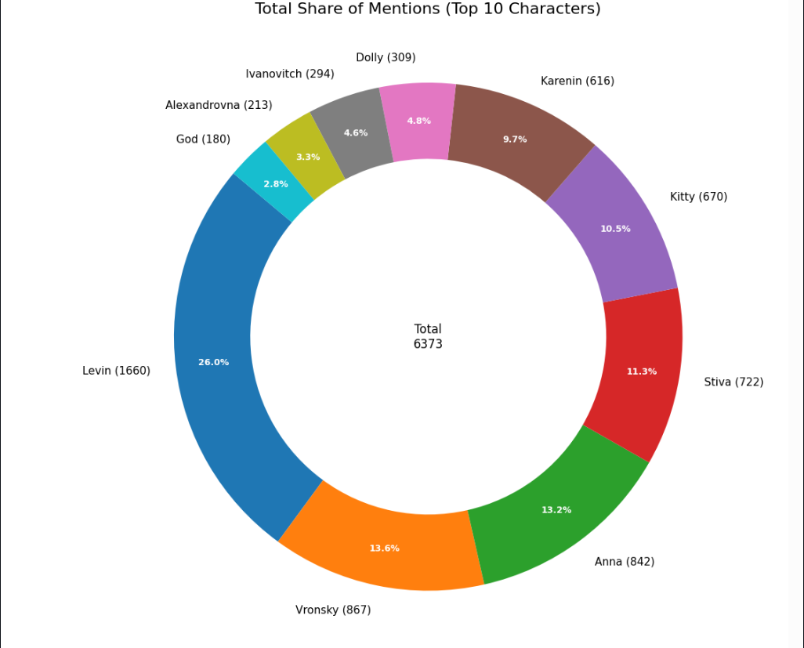
Share of Mentions (%) by Character
“Total mentions: 6373”
Levin has the largest share (26%)
Anna is 13%
“Data processed with Python” using pandas, NLTK/spaCy, regex, matplotlib'

Slide 9
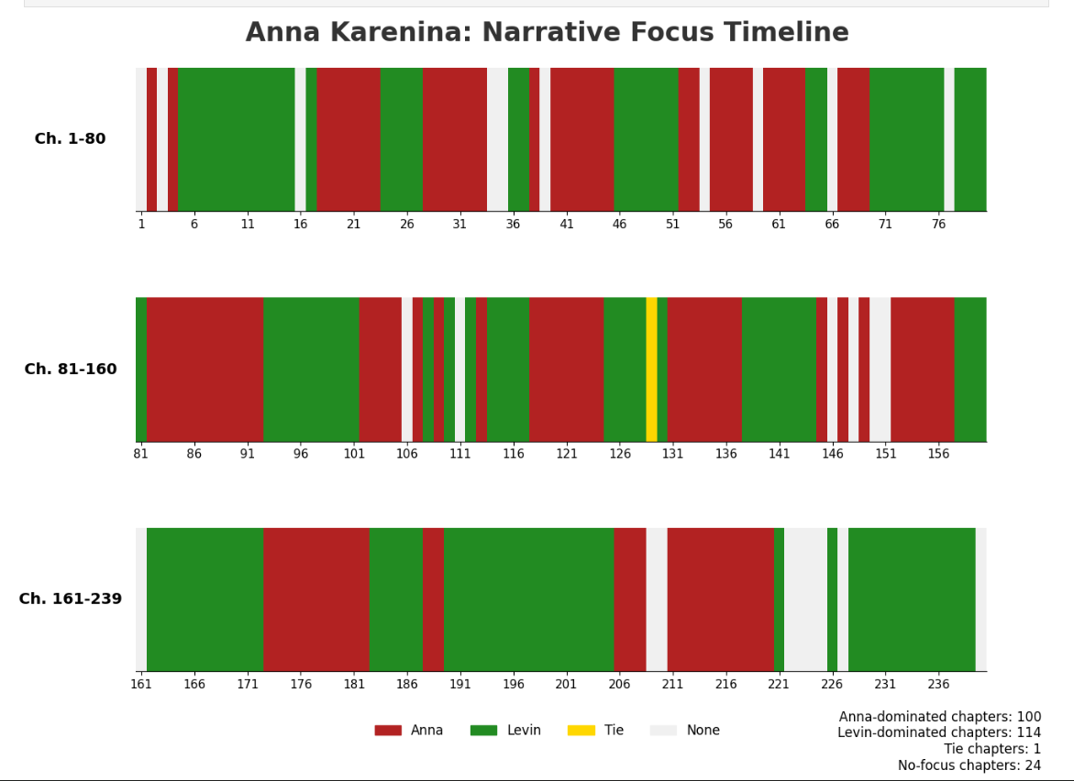
focus timeline
Bullet points:
Legend:
Red = Anna
Green = Levin
Yellow = Tie
White = None
Tools: numpy, pandas, pathlib, re, matplotlib

Slide 10

THE EVIDENCE FOR ANNA
Influence analysis (Quality)
2nd Metric

Slide 11
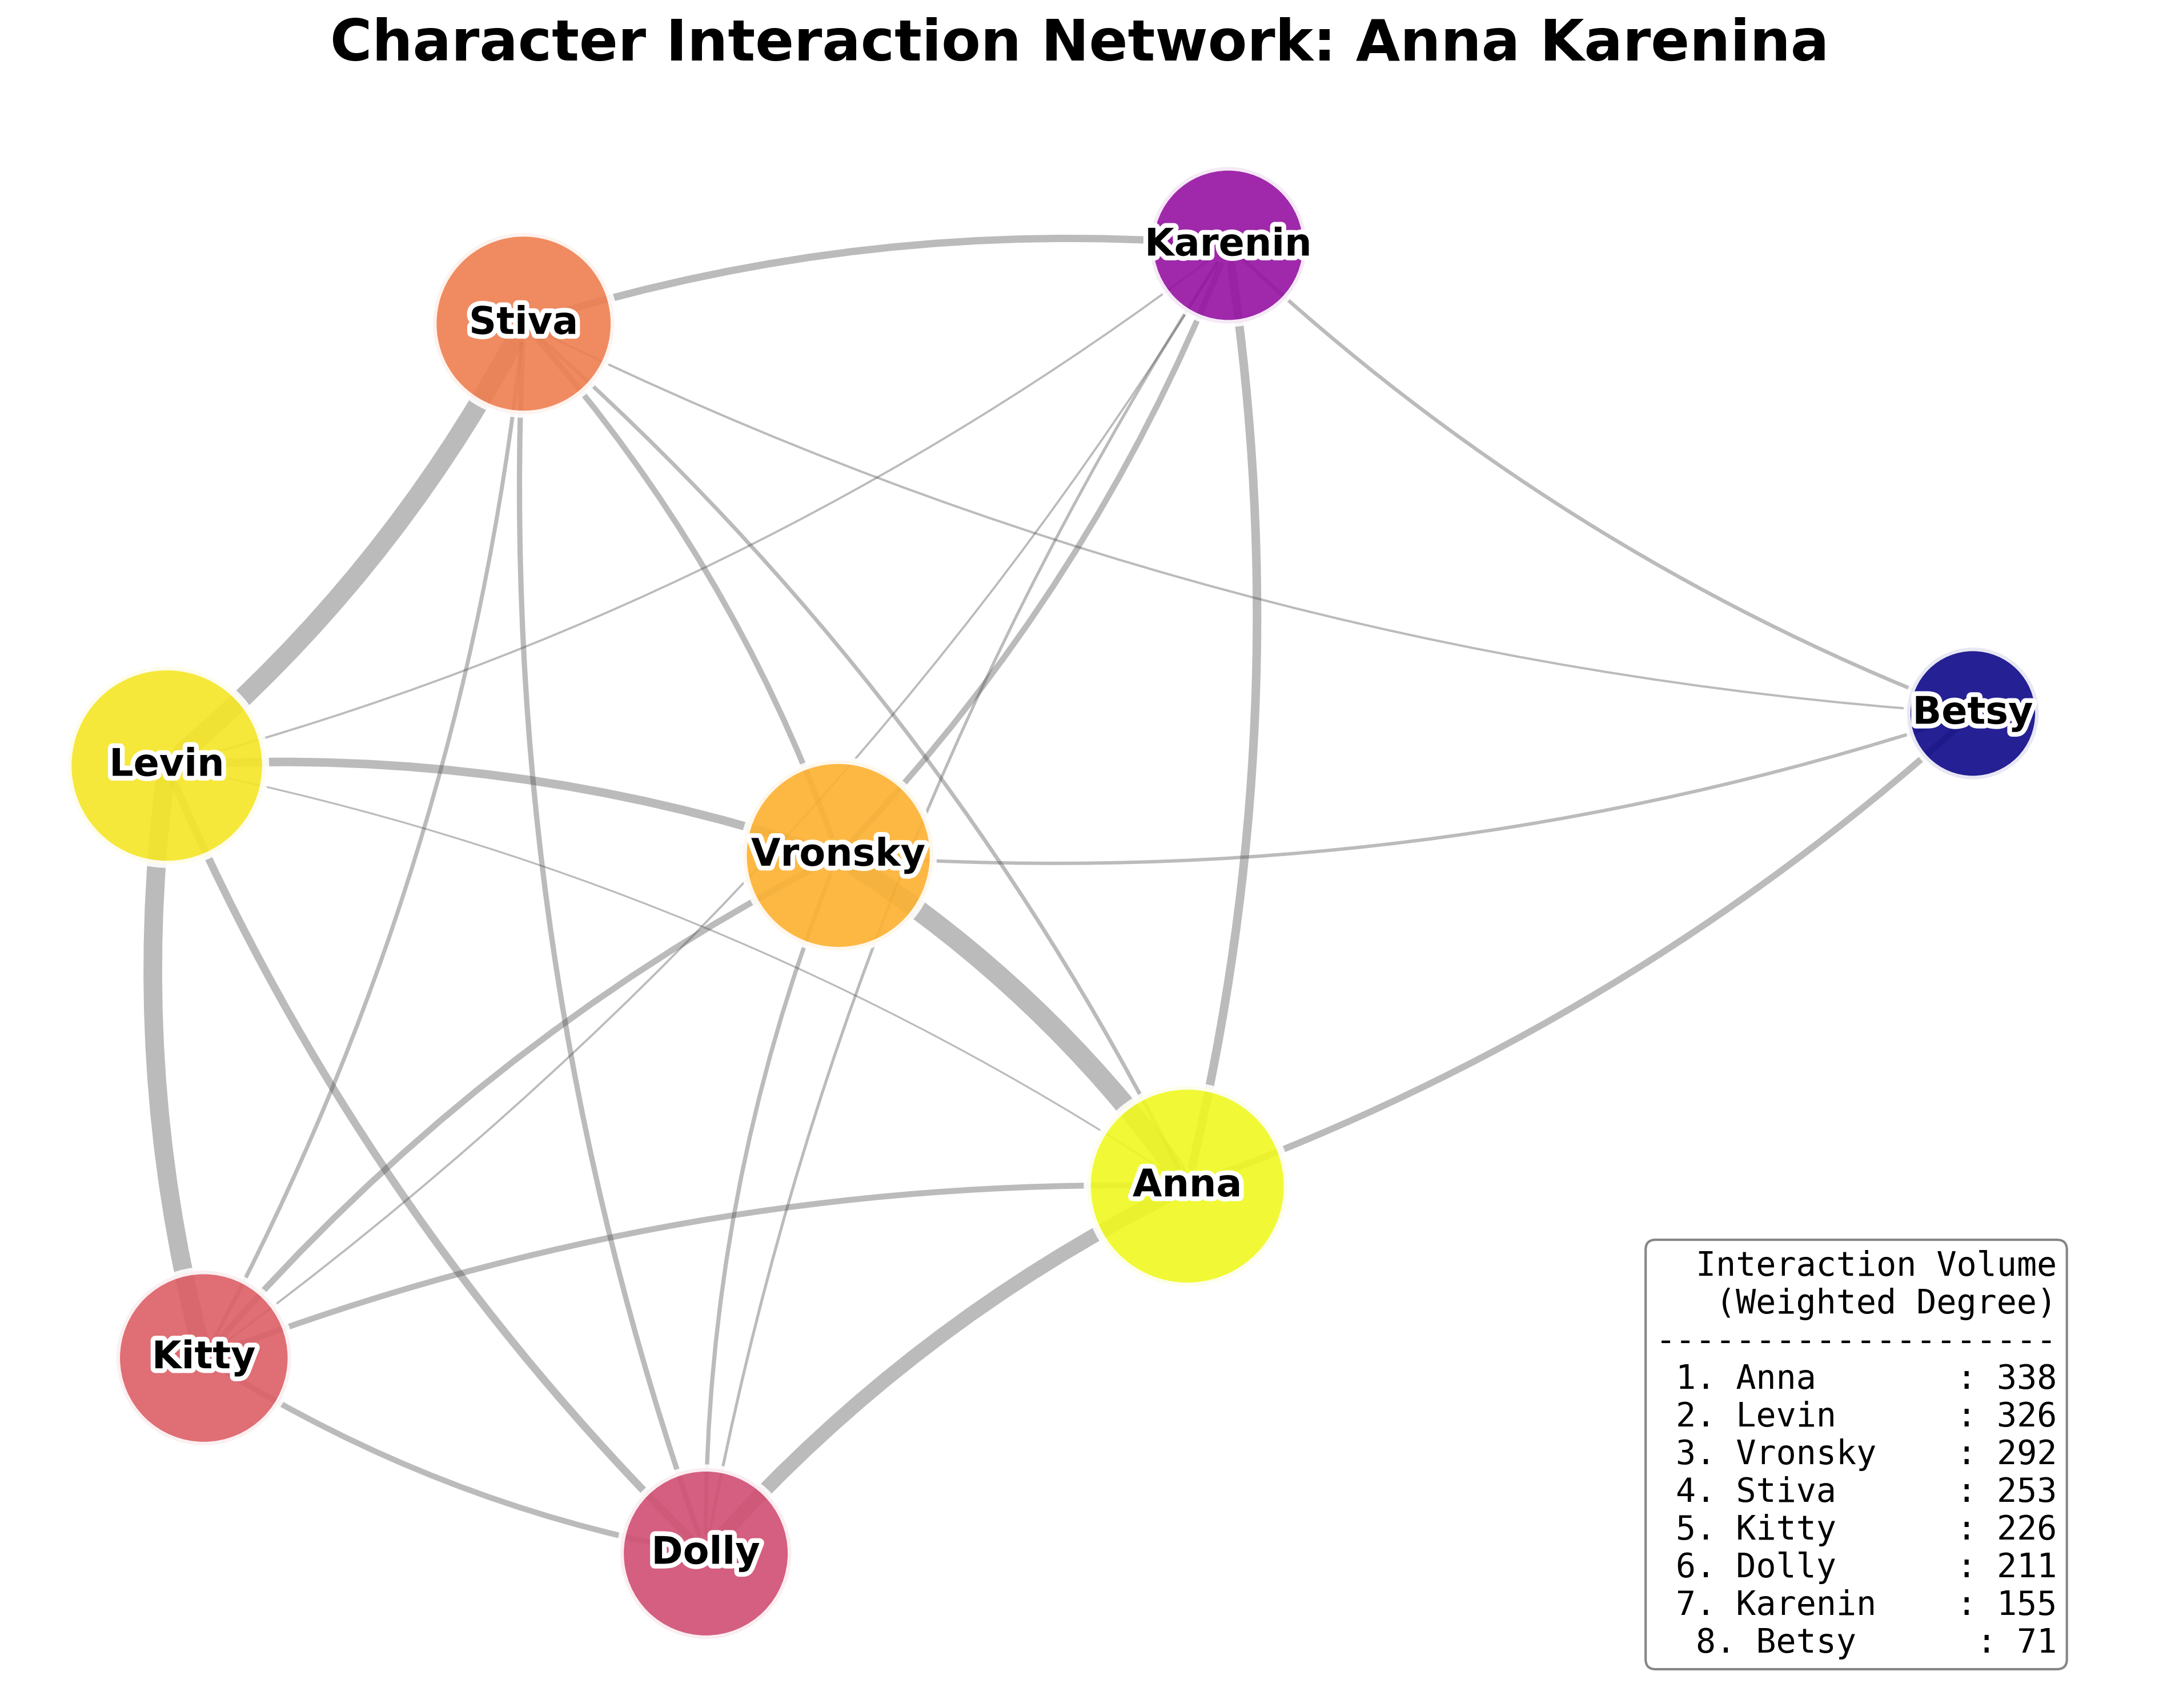
THE NETWORK PARADOX
The Metric: We measured Interaction Volume (Weighted Degree).
The Surprise: Levin (326 interactions) is statistically almost as active as Anna (338). He is a heavyweight.
The Hub: Anna is the Structural Center. She connects the disparate worlds (Politics, Society, Family). Without her, the network breaks.
Tools: itertools, networkx, nltk, pandas, IPython, matplotlib

Slide 12
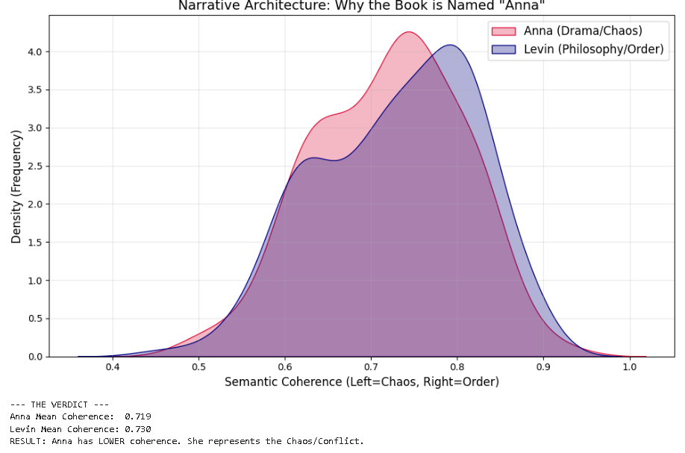
Paragraph Semantic Coherence
The Metric: We measured Semantic Coherence to determine if the narrative voice was "stable" or "chaotic."
The Data: Levin (0.730) scores higher than Anna (0.719). The difference is statistically significant.
The Insight: Anna represents Entropy and Drama (lower coherence). Levin represents Order and Philosophy. The novel needs Anna's chaos to drive the plot.
Tools: datetime, matplotlib, numpy, pandas, regex, seaborn, sentence_transformers, sys, PyTorch, transformers

Slide 13

FINAL VERDICT
What do we understand so far?

Slide 14
FINAL VERDICT
The Case for Levin (Quantity):
Winner: Total Mentions & Focus Timeline.
Role: He dominates the Volume of the text. He represents the novel's Expanse (Philosophy, Agriculture, Russia).
The Case for Anna (Quality):
Winner: Paragraph Semantic Coherence & Network Centrality.
Role: She dominates the Structure of the text. She represents the novel's Focus (Drama, Society, Connection).
Conclusion:
The Title is Accurate.
While Levin provides the voice, Anna provides the gravity. She is the structural hub that connects the novel's disparate worlds; without her, the network collapses.

Slide 15
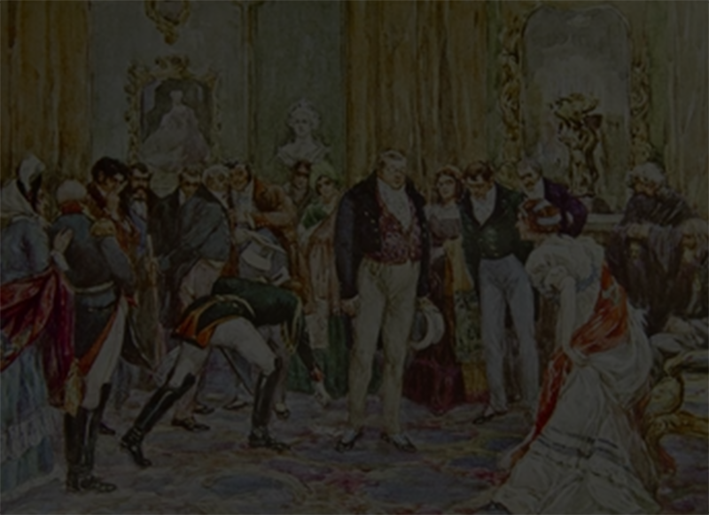
About us
Jakhongir Erkinov
Jak.infosec@gmail.com
Joranas Cigas
jorceebusiness@gmail.com
Chriswin Baiju
chriswinbaiju25@gmail.com
Daved Tawdros
davidayad.2006@gmail.com

